Slide 1

Deliverable 4
Data Modeling and Starting Design

Slide 2
Who Are We?
Muhammad Hamza - Project Manager
Siril Pattammady - Systems Developer
Josh Johnson - Systems Analyst
Khadija Shafiq - Business Analyst
Jay Patel - Network Engineer
Shaikha Al Shamsi - Requirement Analyst

Slide 3


Recap of Osiris Merger w/ Smith and Nephew
The Osiris to Smith and Nephew merger has lead to a large scale integration project for laptop deployment and network development. This involves the implementation of the Smith and Nephew information technology department to create a standalone windows image, to supply necessary resources, and to configure systems on a user to user need basis and as a company as a whole.

Slide 4
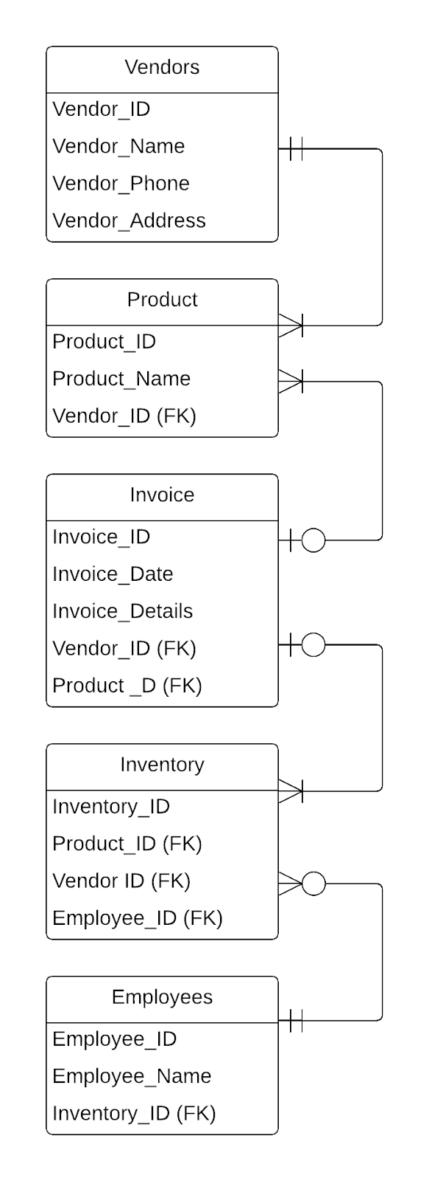
Entity-Relationship
Diagram in the
third normal form

Slide 5
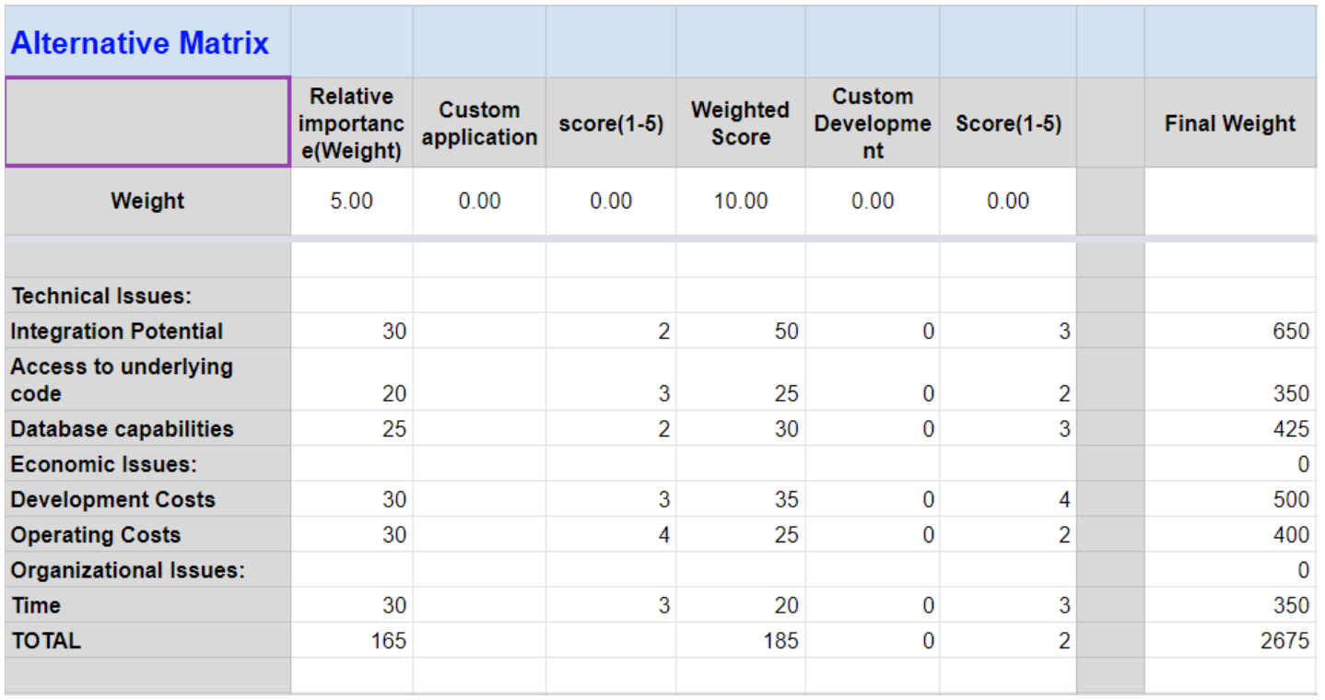
Alternative Matrix

Slide 6
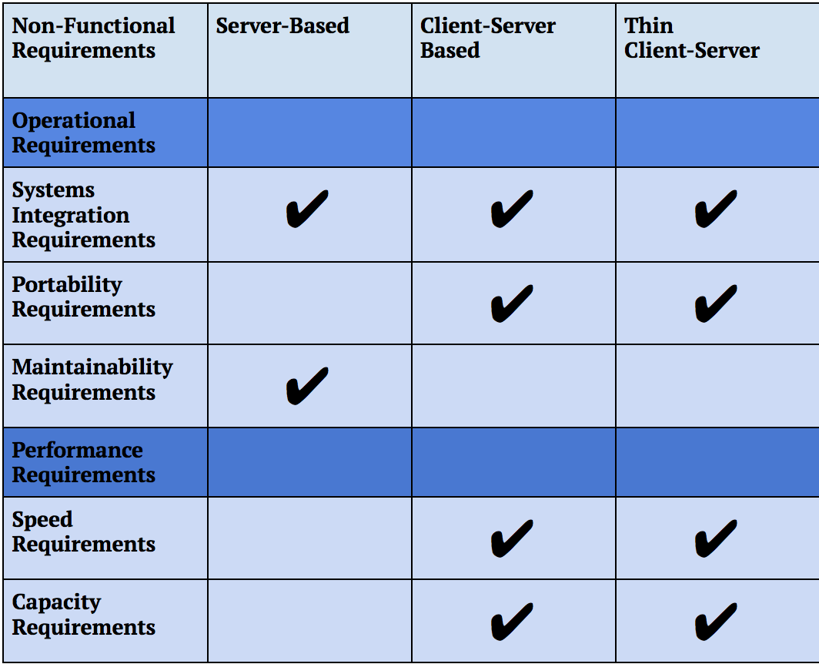
Architecture
of the
System

Slide 7
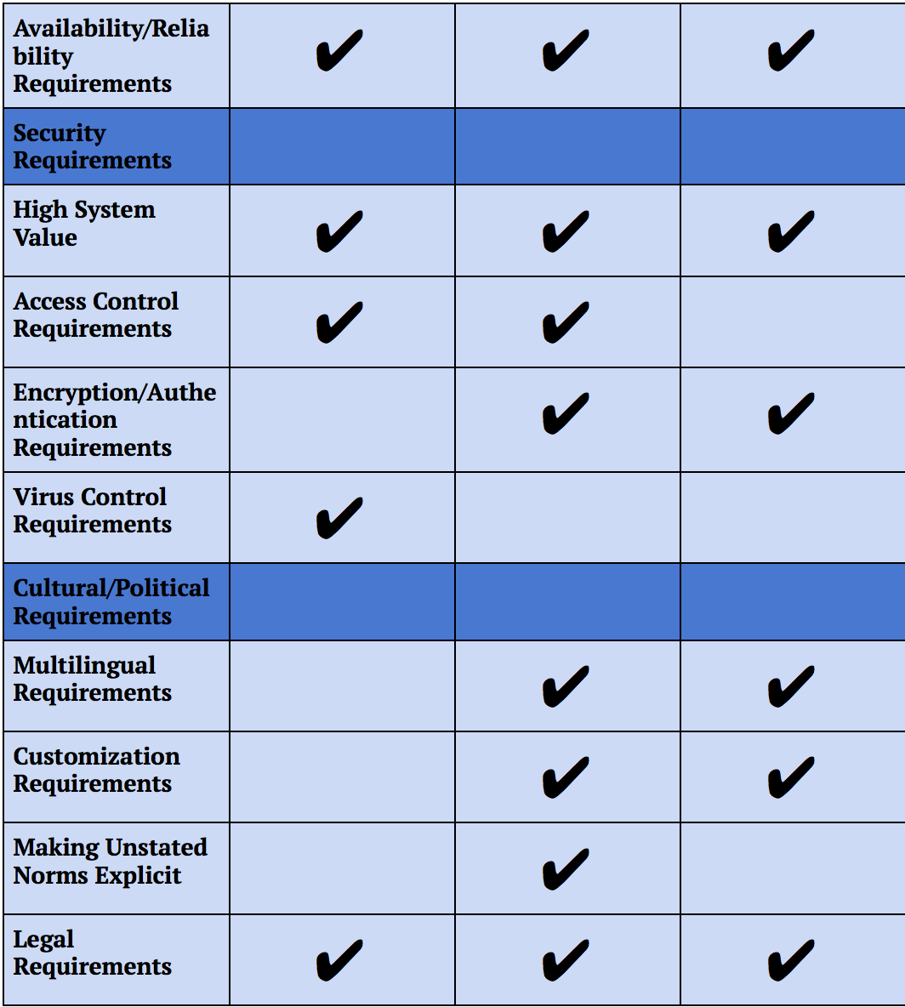
Architecture
of the System

Slide 8
Most compatible Architecture with our design
Client-Server Based:
A balanced process between client device and server devices. This implementation seems to work the best with our architecture since clients are responsible for logic and decision making while the server is responsible for data access/storage. In our architecture our clients make requests based on our database storage which is stored using server (to be cloud based). This model satisfies most of the requirements from security since it is highly reliable, performance, operational, and a common cultural/political requirements.

Slide 9
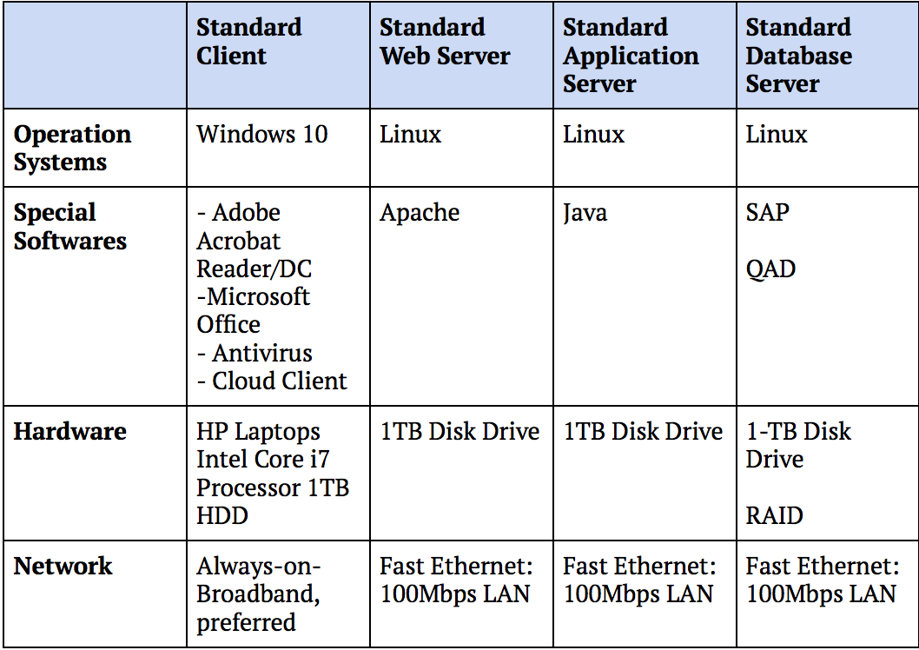
Hardware/Software Specification

Slide 10

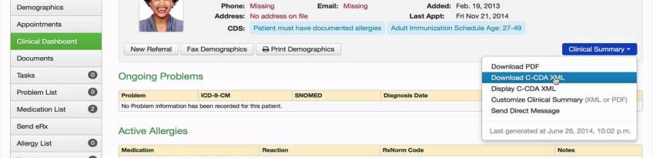
Project Integration: EMR System
Using the system to assist with existing electronic medical record systems, EMRs, to be backed up to the cloud to manage patient records
Document control solution (document management solution) for inhouse records to be put in a cloud environment
Using network drives, to make that switch to a cloud based data storage instead of using local storage
Common data format

Slide 11
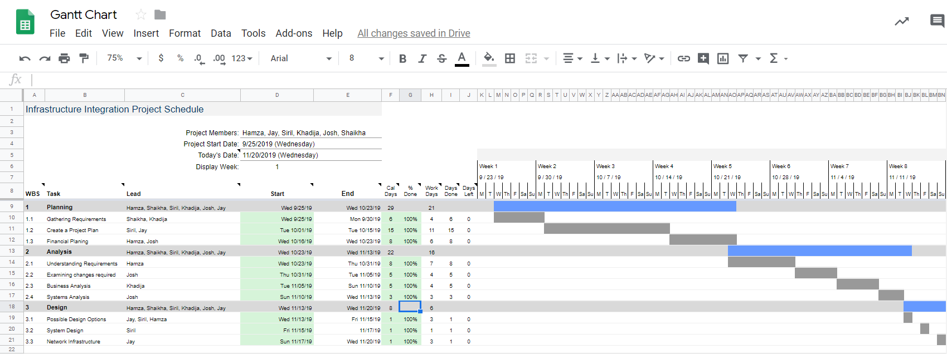
Project Plan

Slide 12
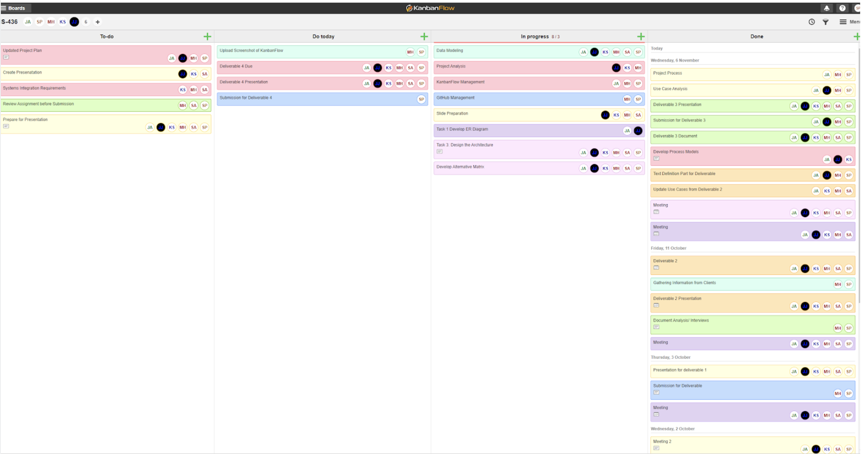
KanbanFlow

